Slide 1



eValueX
Treasury Club Conference – Budapest
Liquidity Management in a Zero-Rate Environment

Slide 2
Presentation Agenda
Brief SuperDerivatives Overview:
  Products, Services and Awards at a glance
  Few Corporate Customers
Zero Rate effects and Challenges
CorporeX
  Mitigating risks and challenges

Slide 3






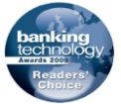
Products, Services and Awards at a glance
DGX
Cross-Asset market data, commentaries and news pages on a real time basis
Chat, Charts, Historical Analysis and Alerts
Awards
Inside Market Data Awards:
2011, 2012, 2013: Best Data Provider for Derivatives
Web-based real-time multi asset front office system
Complete workflow automation; built-in CRM, RFQ
Term Sheets and Client Reports generation,
Comprehensive risk management for corporate treasury
Combination of exposure management and hedging with
decision support as well as booking capabilities
Markets Choice Awards:
2013: Best New Market Data Product
Risk Magazine:
2011: Best Pricing and Analytics (Forex) vendor
Independent revaluation of entire portfolios
Provides investors with transparency
Compliance with accounting regulations
Futures and Options World:
2011: Best innovation in Risk Management
Volatility Surfaces and curves across all asset classes
Real time market data and market commentary
IAIR Awards:
2011: Excellence for FX services, special category: Financial Transparency
Multi-bank trading platform for FX options
Anonymous trading and simultaneous delivery of fast and secure
options pricing from multiple banks
Institutional Investor 2010 Tech 40:
Ranked among the top 40 companies in the financial technology sector
Real time multi-asset risk and position management system
covering all option products in the market place
Complements existing systems, enabling front office derivatives
management and back office risk management
Banking Technology Awards:
2009: Highly commended in the Most Innovative New Product or Service category

Slide 4







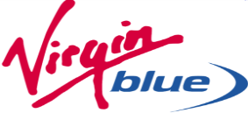














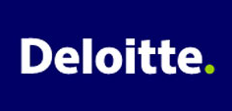




A Few Existing Corporate Clients

Slide 5
Zero Rate effects and Challenges
Foreign Exchange:
Currency Volatility
  Adds tremendous uncertainty to company earnings which impacts shareholder value as shareholders do not like earnings volatility.
  Adversely affecting profitability and stability as un-hedged currency moved can cost a company millions.
Interest Rates:
Appetite for EUR and USD loans
Increased appetite for swaps rather than interest rate volatility products.
Inflation:
Inflation Exposures

Slide 6
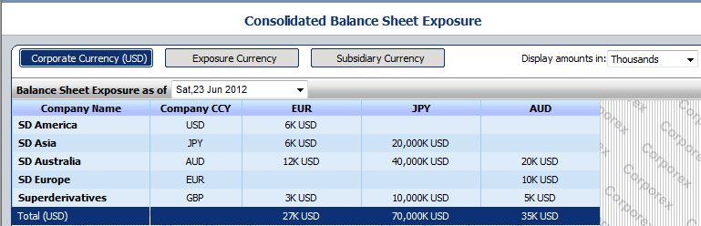
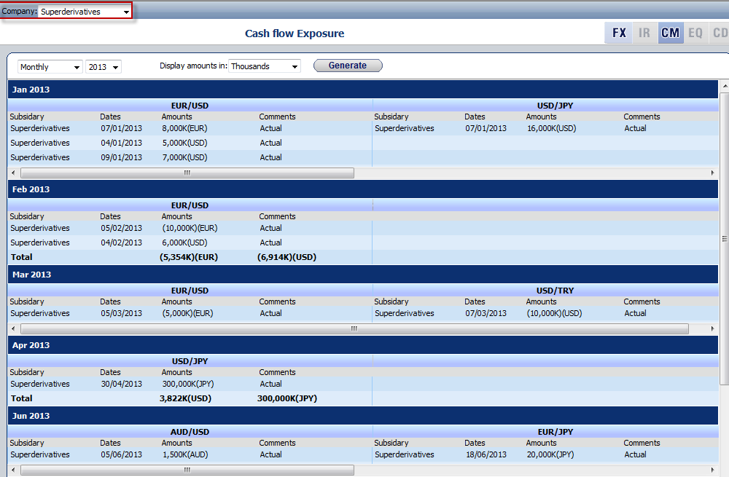
CorporeX
  Balance Sheet Exposure
    Per Company\Subsidiary
    Various amounts display
    Display exposure by:
      Corporate currency
      Subsidiary Currency
      Exposure Currency
Exposure Management views
  Cash Flow Exposure
    Per Company\Subsidiary
    Various amounts display
    Display Exposure Summary by:
      Yearly
      Semi-anualy
      Quarterly
      Monthly
      Weekly

Slide 7
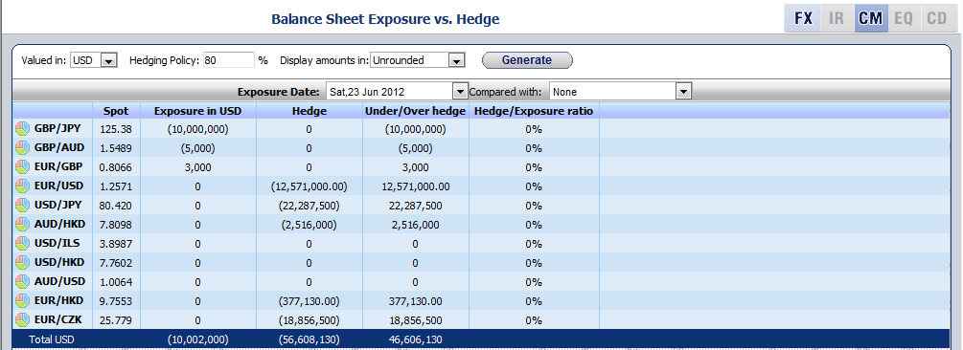
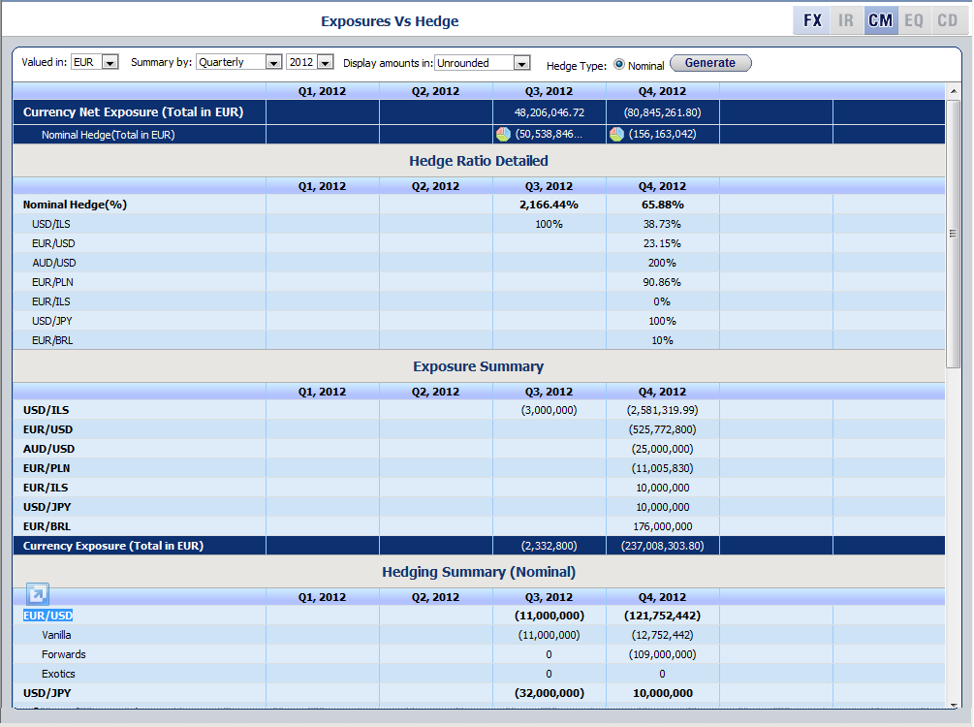
CorporeX: Exposures vs. Hedge
  Monitor and Track exposure in real time
  Supported for
    Balance Sheet
    Cash Flow
  Enables to view and analyze
    Net exposure per underlying
    Relevant hedge positions associated to each exposure.
    Hedge Ratio (Hedge/Exposure)

Slide 8
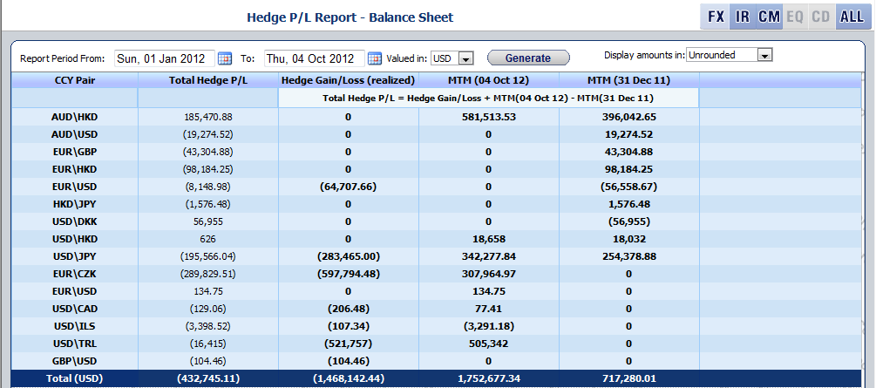
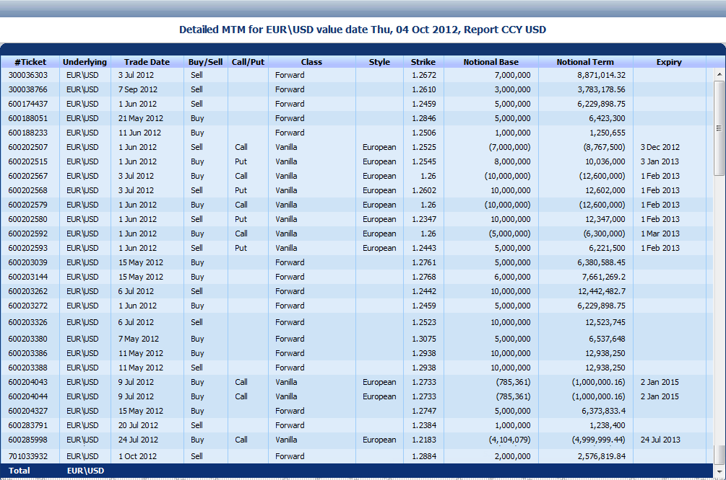
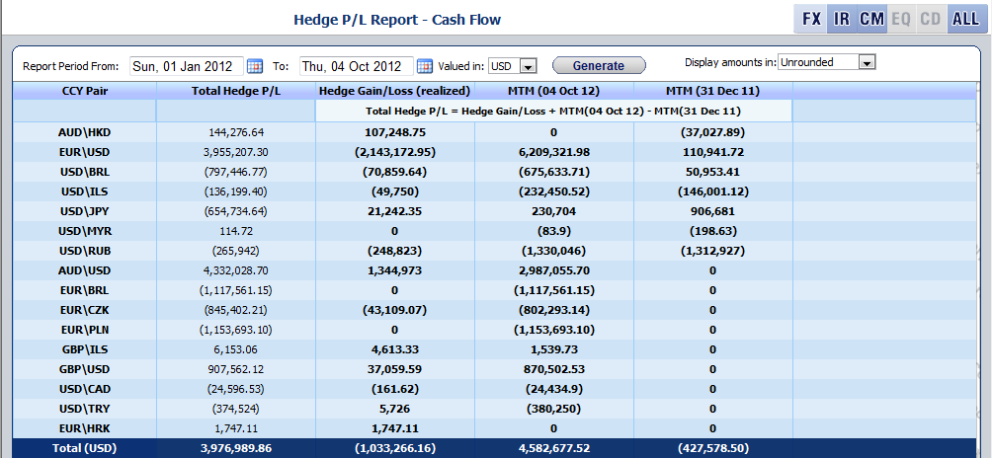
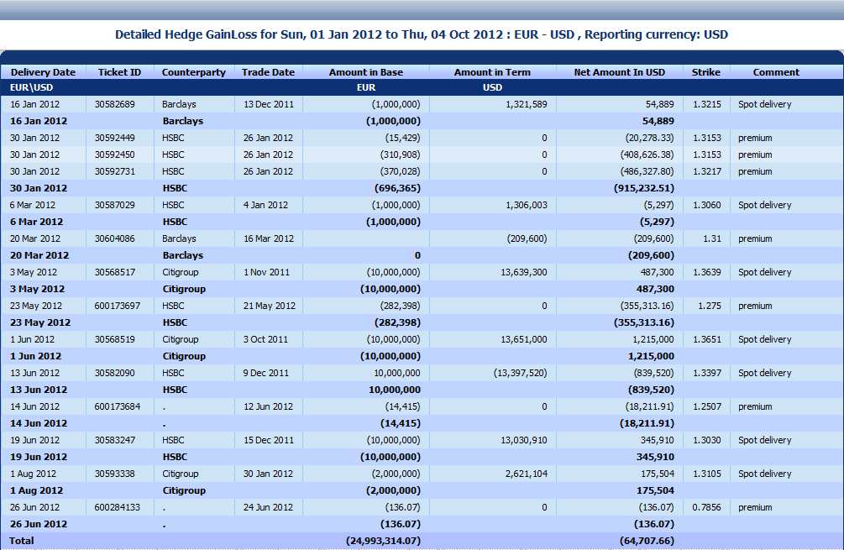
Hedge P/L Report
  Measures the profit / loss of the company’s hedge position between two chosen dates.
  Supported for
    Balance Sheet
    Cash Flow
  All numbers open a drill down which allows to analyze the underlying deals and market values.

Slide 9
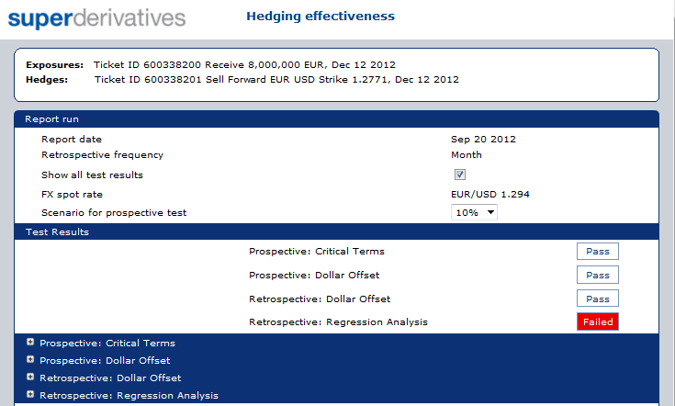
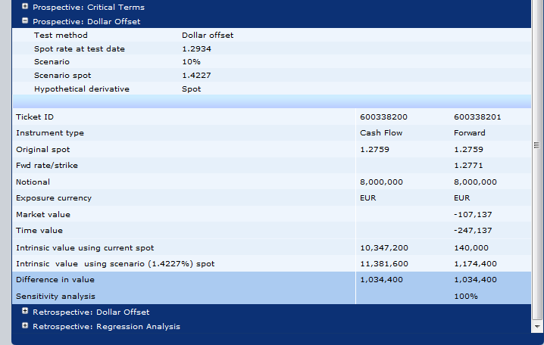
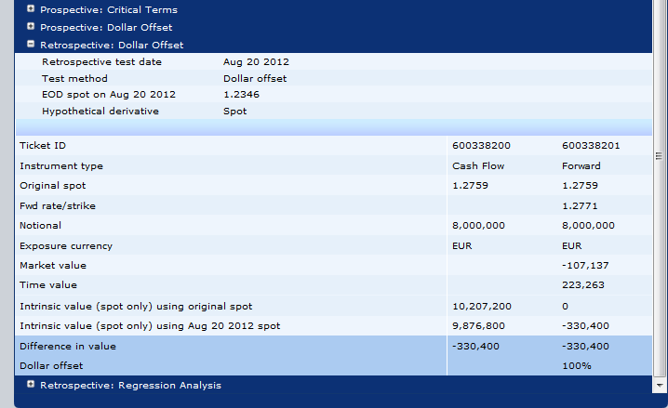
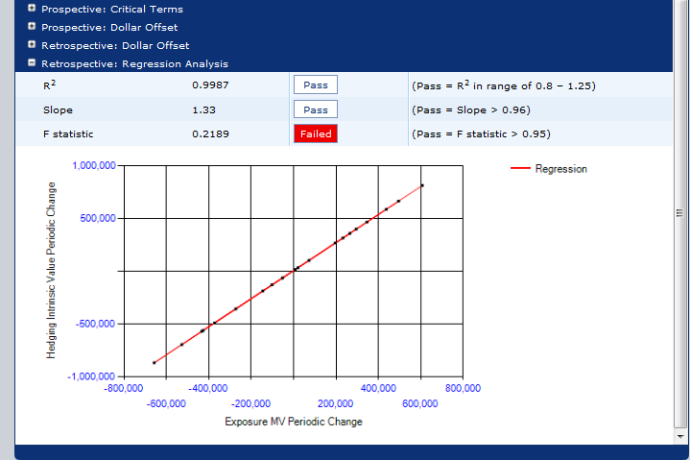
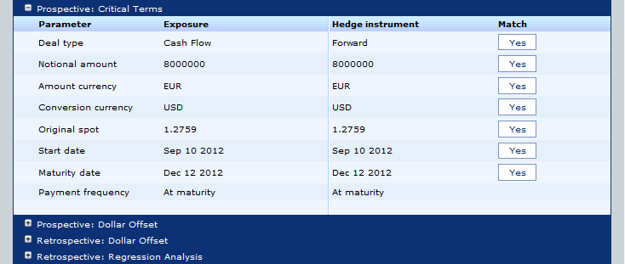

Hedge Effectiveness FX
Link any Hedge (Forward, Risk Reversal, etc’) with an exposure and run a Hedge Effectiveness Report

Slide 10
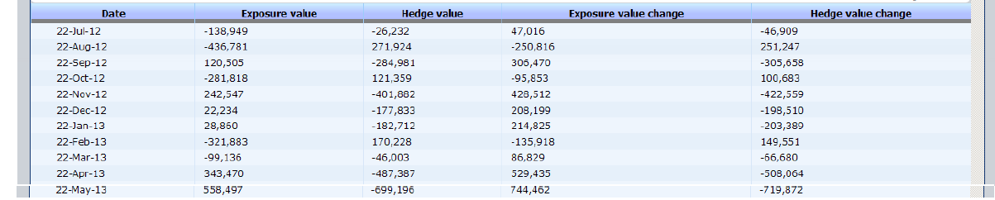
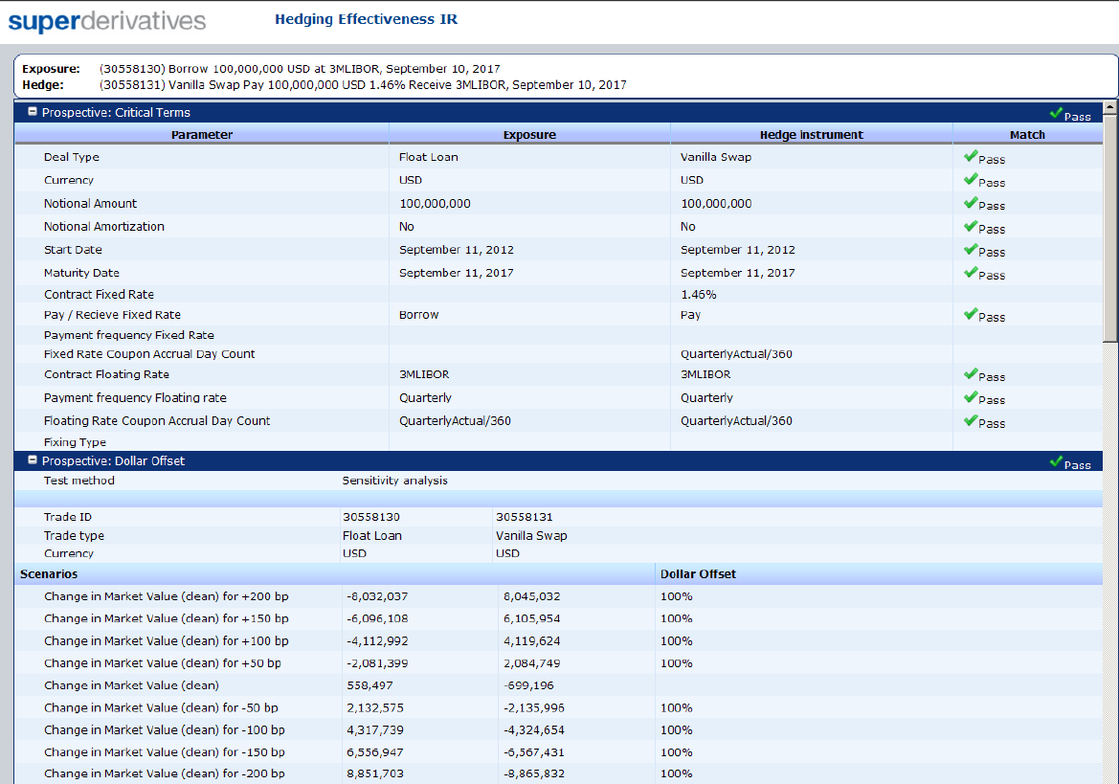
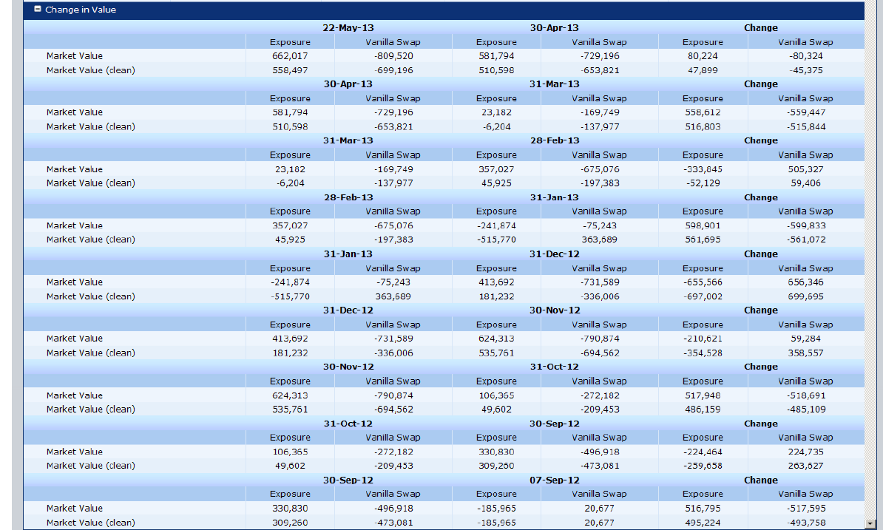
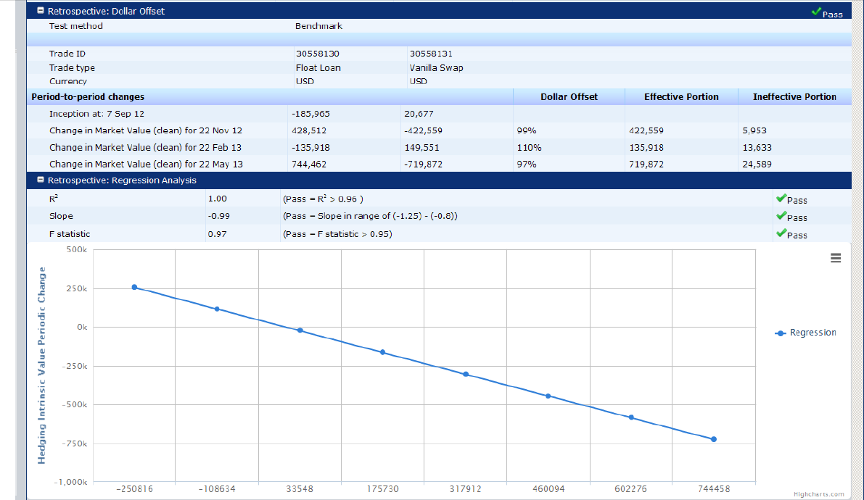
Hedge Effectiveness IR
Link any Hedge (Swap, Cap\Floor, etc’) with an exposure (Loan) and run a Hedge Effectiveness Report

